Slide 1
DATABASE MANAGEMENT SYSTEMS
Subject Teacher: Junaid Javed Korai

Slide 2
GROUP FUNCTIONS
Lecture # 15
Disclaimer: The material used in this presentation to deliver the lecture i.e., definitions/text and pictures/graphs etc. does not solely belong to the author/presenter. The presenter has gathered this lecture material from various sources on web/textbooks. Following sources are especially acknowledged:
Connolly, Thomas M., and Carolyn E. Begg. Database systems: a practical approach to design, implementation, and management. Pearson Education, 2005.
Gorman,Tim, Inger Jorgensen, Melanie Caffrey, and Lex deHaan. Beginning Oracle SQL: For Oracle Database 12c.Apress, 2014.
Greenberg, Nancy, and Instructor Guide PriyaNathan. "Introduction to Oracle9i: SQL." ORACLE, USA (2001).
2

Slide 3
OBJECTIVES
After completing this lesson, you should be able to do the following:
Identify the available group functions
Describe the use of group functions
Group data using the GROUP BY clause
Include or exclude grouped rows by using the HAVING clause

Slide 4
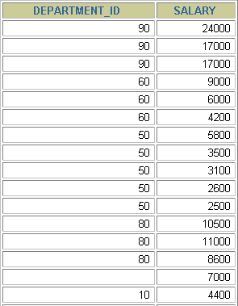

Group functions operate on sets of rows to give one result per group.
WHAT ARE GROUP FUNCTIONS?
EMPLOYEES
The maximum salary in
the EMPLOYEES
table.
…

Slide 5
TYPES OF GROUP FUNCTIONS
AVG
COUNT
MAX
MIN
STDDEV
SUM
VARIANCE

Slide 6
SELECT FROM [WHERE [GROUP BY [ORDER BY
GROUP FUNCTIONS SYNTAX
[column,] group_function(column), ... table
condition] column] column];

Slide 7
USING THE AVG AND SUM FUNCTIONS
You can use AVG and SUM for numeric data.
SELECT AVG(salary), MAX(salary),
MIN(salary), SUM(salary)
employees
FROM
WHERE
job_id LIKE '%REP%';

Slide 8
USING THE MIN AND MAX FUNCTIONS
You can use MIN and MAX for any data type.
SELECT | MIN(hire_date), MAX(hire_date)
FROM employees;

Slide 9
USING THE COUNT FUNCTION
COUNT(*) returns the number of rows in a table.
SELECT | COUNT(*)
FROM employees WHERE department_id = 50;

Slide 10
USING THE COUNT FUNCTION
COUNT(expr) returns the number of rows with non-null values for the
expr.
Display the number of department values in the EMPLOYEES table, excluding the null values.
SELECT FROM WHERE
COUNT(commission_pct)
employees department_id = 80;

Slide 11
USING THE DISTINCT KEYWORD
COUNT(DISTINCT expr) returns the number of distinct non-null values of the expr.
Display the number of distinct department values in the EMPLOYEES
table.
SELECT | COUNT(DISTINCT department_id)
FROM employees;

Slide 12
GROUP FUNCTIONS AND NULL VALUES
Group functions ignore null values in the column.
SELECT FROM
AVG(commission_pct)
employees;

Slide 13
USING THE NVL FUNCTION WITH GROUP FUNCTIONS
The NVL function forces group functions to include
null values.
SELECT AVG(NVL(commission_pct, 0)) FROM employees;

Slide 14
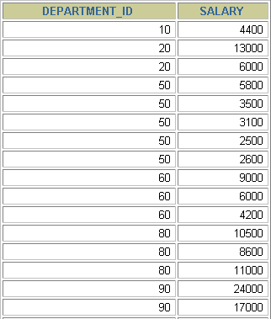
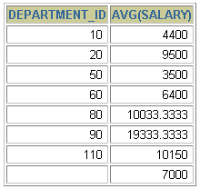
EMPLOYEES
CREATING GROUPS OF DATA
4400
9500
The
average
₃₅₀₀ salary
in
EMPLOYEES
table
6400
for each
department.
10033
…

Slide 15
CREATING GROUPS OF DATA: THE GROUP BY CLAUSE SYNTAX
SELECT FROM [WHERE
column, group_function(column) table
condition]
[GROUP BY [ORDER BY
group_by_expression] column];
Divide rows in a table into smaller groups by using the
GROUP BY clause.

Slide 16
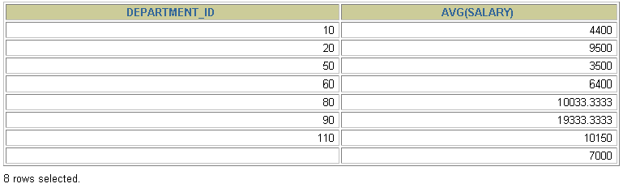
USING THE GROUP BY CLAUSE
All columns in the SELECT list that are not in group
functions must be in the GROUP BY clause.
SELECT department_id, AVG(salary) FROM employees
GROUP BY department_id ;

Slide 17
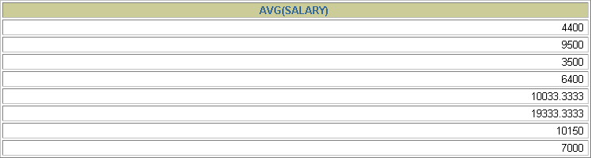
USING THE GROUP BY CLAUSE
The GROUP BY column does not have to be in the
SELECT list.
SELECT FROM
AVG(salary) employees
GROUP BY department_id ;

Slide 18
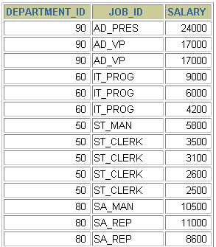
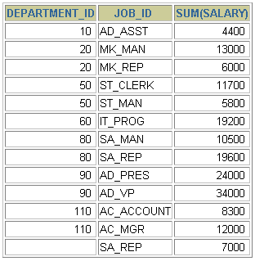

GROUPING BY MORE THAN ONE COLUMN
EMPLOYEES
“Add up the
salaries in
the EMPLOYEES
table for each job, grouped by department.
…

Slide 19
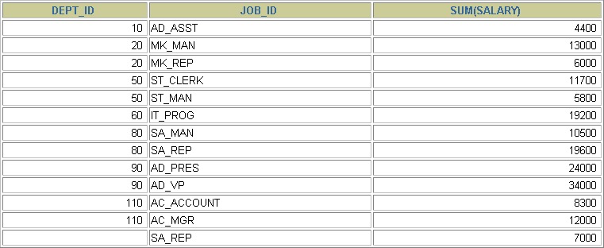
USING THE GROUP BY CLAUSE ON MULTIPLE COLUMNS
SELECT
FROM
department_id dept_id, job_id, SUM(salary)
employees
GROUP BY department_id, job_id
;

Slide 20



Any column or expression in the SELECT list that is not an aggregate function must be in the GROUP BY clause.
ILLEGAL QUERIES USING GROUP FUNCTIONS
SELECT department_id, COUNT(last_name) FROM employees;
SELECT department_id, COUNT(last_name)
*
ERROR at line 1:
ORA-00937: not a single-group group function

Slide 21


ILLEGAL QUERIES USING GROUP FUNCTIONS
You cannot use the WHERE clause to restrict groups.
You use the HAVING clause to restrict groups.
You cannot use group functions in the WHERE clause.
SELECT FROM WHERE
department_id, AVG(salary)
employees
AVG(salary) > 8000
GROUP BY department_id;
WHERE AVG(salary) > 8000
*
ERROR at line 3:
ORA-00934: group function is not allowed here

Slide 22
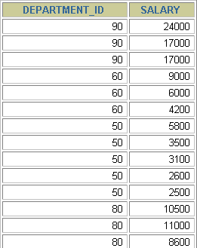
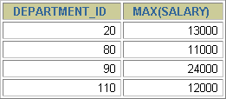

EXCLUDING GROUP RESULTS
EMPLOYEES
The maximum
salary
per department when it is greater than
$10,000
…

Slide 23
EXCLUDING GROUP RESULTS:THE HAVING CLAUSE
Use the HAVING clause to restrict groups:
Rows are grouped.
The group function is applied.
Groups matching the HAVING clause are displayed.
SELECT FROM [WHERE [GROUP BY
column, group_function
table
condition] group_by_expression]
[HAVING
group_condition] column];
[ORDER BY

Slide 24
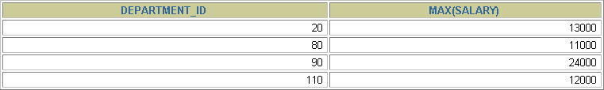
USING THE HAVING CLAUSE
SELECT FROM
department_id, MAX(salary) employees
GROUP BY department_id
HAVING MAX(salary)>10000 ;

Slide 25

USING THE HAVING CLAUSE
SELECT FROM WHERE
job_id, SUM(salary) PAYROLL employees
job_id NOT LIKE '%REP%'
GROUP BY job_id
HAVING SUM(salary) > 13000
ORDER BY SUM(salary);

Slide 26
NESTING GROUP FUNCTIONS
Display the maximum average salary.
SELECT
FROM
MAX(AVG(salary))
employees
GROUP BY department_id;

Slide 27
SUMMARY
In this lesson, you should have learned how to:
Use the group functions COUNT, MAX, MIN, AVG
Write queries that use the GROUP BY clause
Write queries that use the HAVING clause
SELECT FROM [WHERE
column, group_function(column) table
condition]
[GROUP BY [HAVING [ORDER BY
group_by_expression] group_condition] column];

